Slide 1

Registering as a HUAWEI Developer
and Making Money with HUAWEI Ads Kit

Slide 2
1
I. Developer Account Registration
2
II. HUAWEI Ads
Contents
3
III. Ad Units and Scenarios
4
IV. HUAWEI Ads Advantages
5
VI. Service Support

Slide 3
Registering as a HUAWEI Developer

Slide 4
Register a HUAWEI ID
A HUAWEI ID is an account used for accessing all the HUAWEI Mobile Services on the HUAWEI Developer platform, enabling a simple and secure sign-up and sign-in.
Visit the HUAWEI Developer platform at https://developer.huawei.com/consumer/en/
If you already have a HUAWEI ID, click the Sign in button in the upper right corner of the page. If you do not have a HUAWEI ID, you click the Sign up button in the upper right corner of the page to enter the registration page

Slide 5
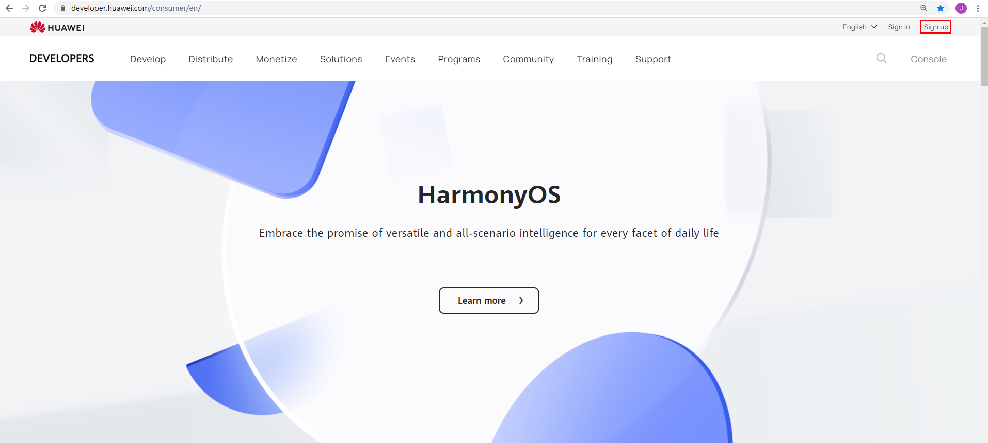

Slide 6
Register a HUAWEI ID
Register a HUAWEI ID with your email address or mobile phone number
If you are registering with your email address, enter a valid email address and verification code (mobile phone number and date of birth are required in some countries or regions)
After setting a password, click REGISTER
If you are registering with your mobile number, enter a valid mobile number and verification code, set the password, and click REGISTER

Slide 7
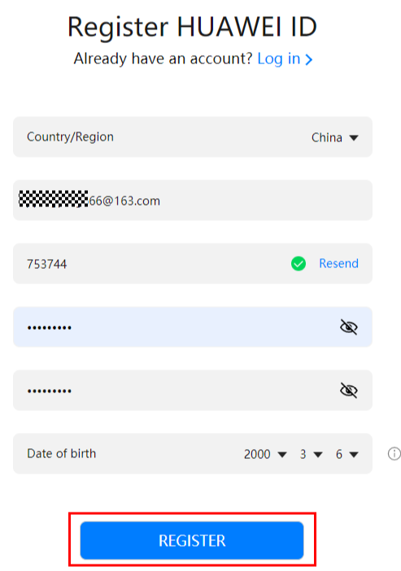
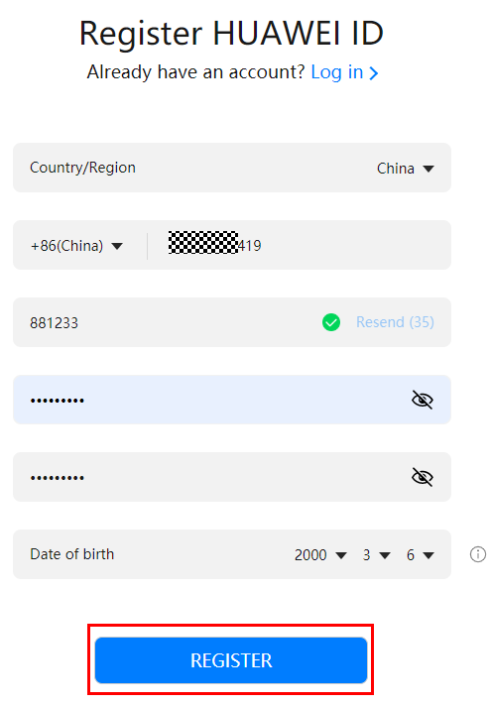

Slide 8
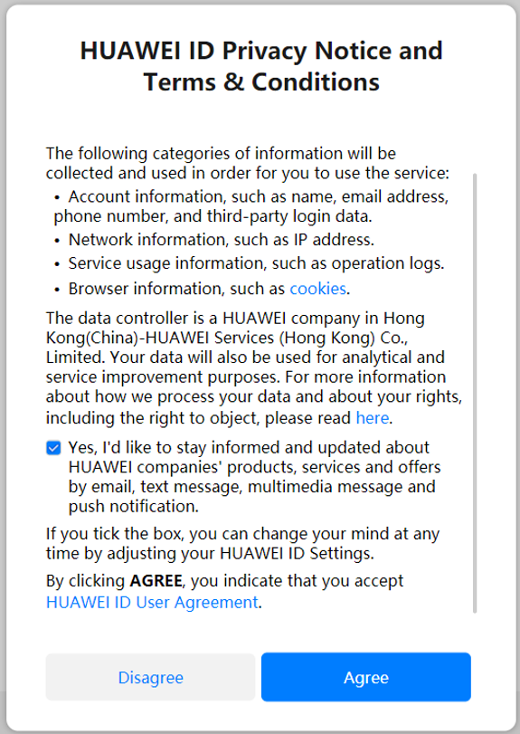
Register a HUAWEI ID
Read and confirm the HUAWEI ID Privacy Notice and Terms & Conditions, and click Agree

Slide 9
Developer identify verification
After successful registration, you need to get your identity verified.
HUAWEI Developers supports two types of developers: enterprise developers and individual developers. Enterprise developers have access to more services than individual developers. Select a developer type based on your needs.
Visit https://developer.huawei.com/consumer/en/doc/help/developerrights-0000001053174003 to find out more about what each developer registration type offers

Slide 10
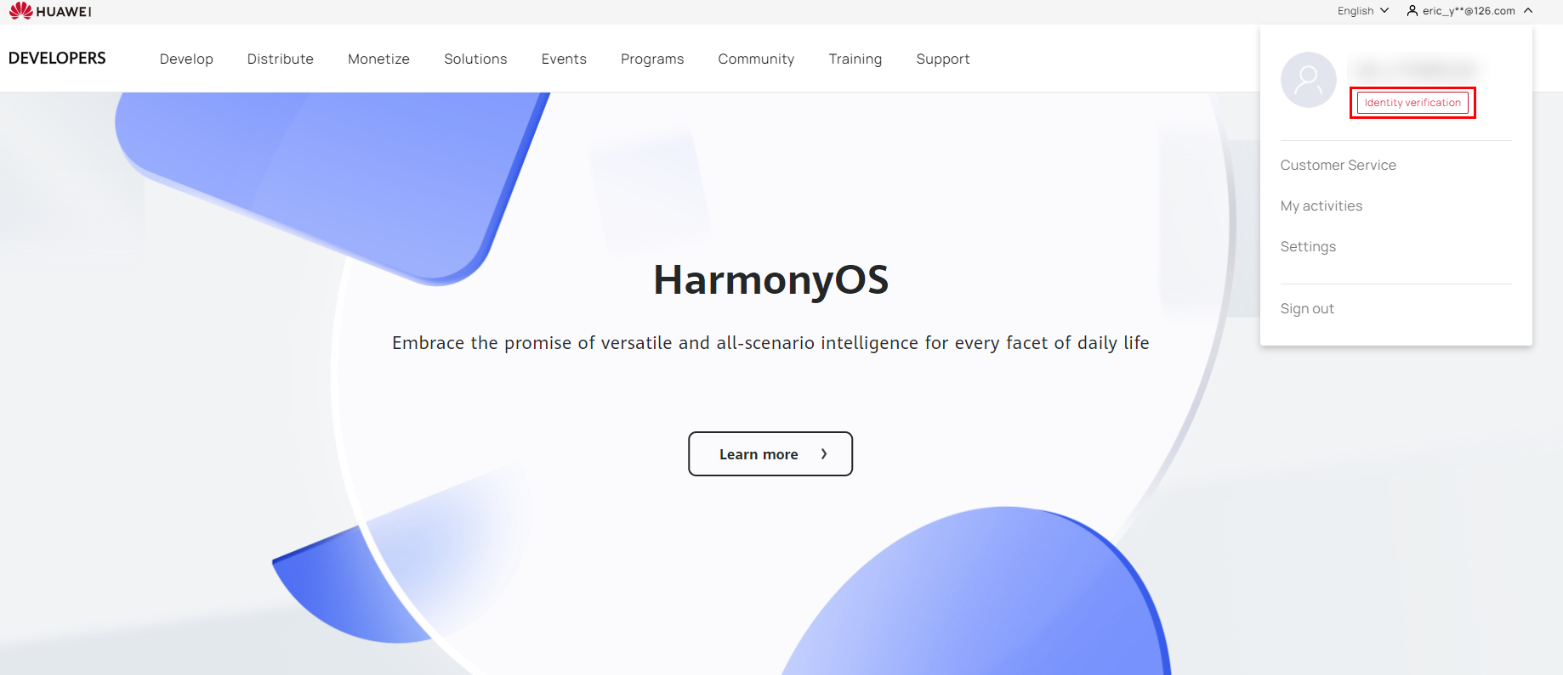
Individual Developer Identity Verification
To get your identity verified, sign in to the HUAWEI Developer platform with your HUAWEI ID and click Console or Identity verification in the upper right corner to go to the identity verification page

Slide 11
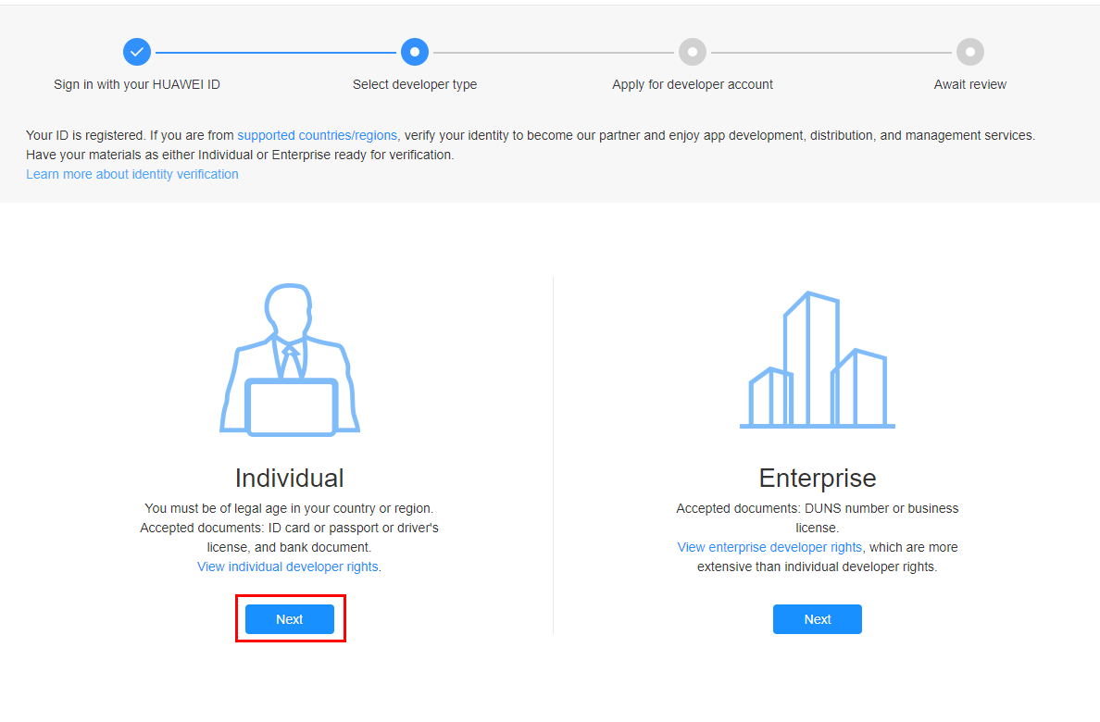
Individual Developer Identity Verification
You must be of legal age in your country or region. On the page for selecting a developer type, click Next under Individual.

Slide 12
Individual Developer Identify Verification
HUAWEI Developers supports multiple identity document combinations for verification, including:
ID card + bank document
Passport + bank document
Other supporting documents (such as driver's license) + bank document

Slide 13
Individual Developer Identify Verification
NOTE:
ID card: Upload a scan of your ID card with your full name in English and a clear photo
Bank document: Upload a scan of your bank card, bank book, bank account opening confirmation letter, bank statement, or any other legally valid document issued by the bank
Passport: Upload a scan of your passport with your full name in English and a clear photo
Other supporting documents: Upload scans of other supporting documents with your full name in English and a clear photo. The document should contain your full name in English and have a validity period of at least 6 months

Slide 14
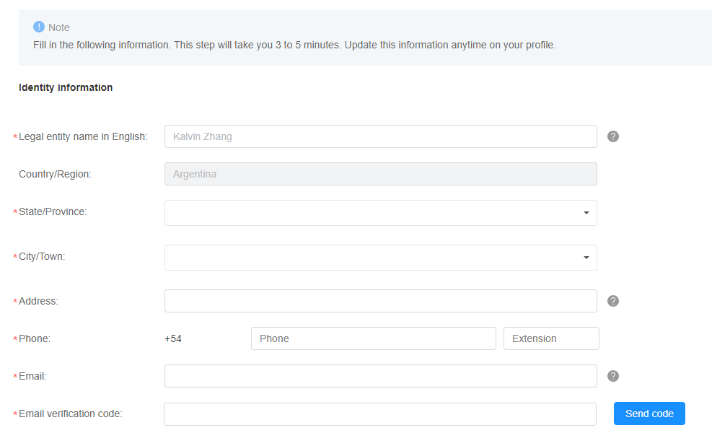
Individual Developer Identity Verification
Enter your information. Parameters marked with a red asterisk (*) are mandatory.

Slide 15
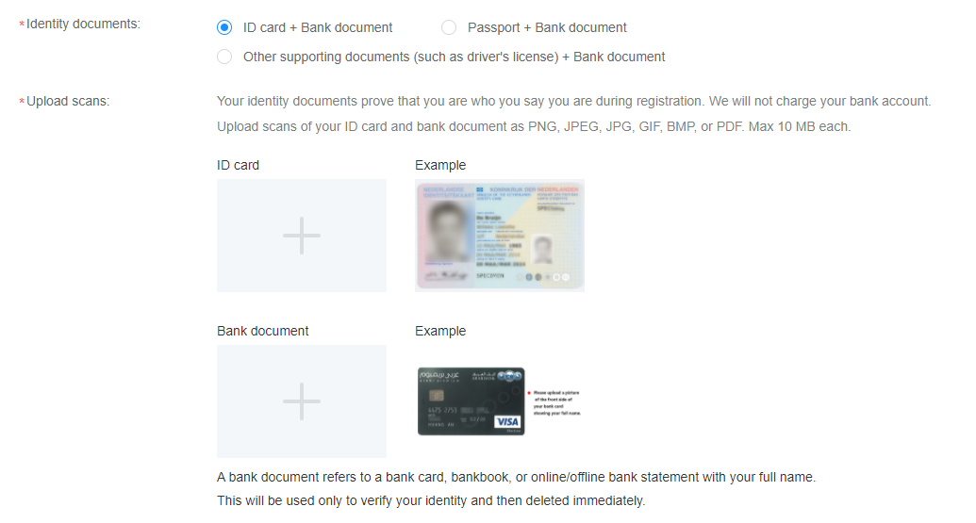
Individual Developer Identity Verification
Upload scans of your identity documents. Using an ID card + bank document as an example, select ID card + Bank document and upload scans of your ID card and bank document with your full name on them.

Slide 16
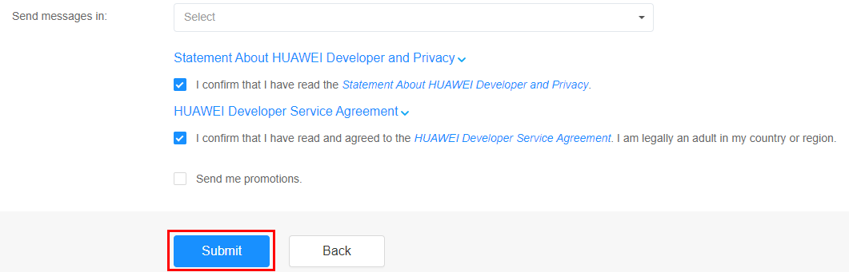
Individual Developer Identity Verification
Read and confirm the Statement About HUAWEI Developer and Privacy and HUAWEI Developer Service Agreement, and click Submit.

Slide 17
Individual Developer Identify Verification
HUAWEI Developers will complete the review within 1 to 2 working days and send the review result to your email address provided in the contact information
You can also check the review result in the notification banner at the top of the HUAWEI Developer platform
If you have any questions during identity verification, you can contact our customer service team by visiting https://developer.huawei.com/consumer/en/support/feedback/#/

Slide 18
Enterprise Developer Identity Verification
To get your identity verified, sign in to the HUAWEI Developer platform with your HUAWEI ID and click Console or Identity verification in the upper right corner to go to the identity verification page

Slide 19
Enterprise Developer Identify Verification
You can use the DUNS number of your company for identity verification.
The Data Universal Numbering System organises commercial information by assigning each company a unique, internationally recognised 9-digit identifier. To look up what your company's DUNS number is, access the DUNS number lookup page on the official DUNS website using your company name and address. This can be accessed by visiting http://www.dnb.com/duns-number/lookup.html
Your DUNS number needs to be active. Ensure it has been renewed in DUNS within the last two years. The company information used for identity verification on the HUAWEI Developer platform must match the information verified by DUNS
If your company does not have a DUNS number, apply for one on the official DUNS website by visiting http://www.dnb.com

Slide 20
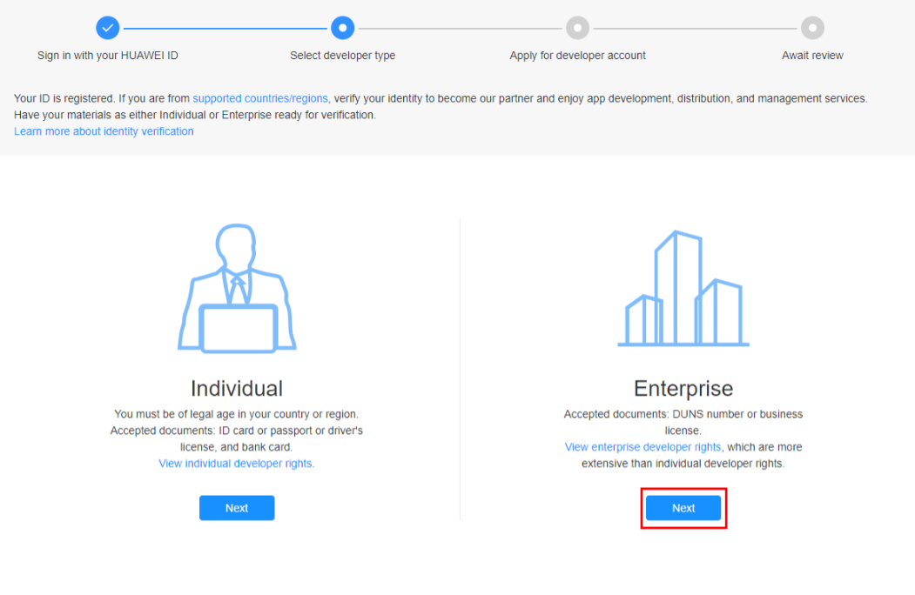
Enterprise Developer Identity Verification
On the page for selecting a developer type, click Next under Enterprise.

Slide 21
Enterprise Developer Identity Verification
Enter your identity information and contact information. Parameters marked with a red asterisk (*) are mandatory
Read and confirm the Statement About HUAWEI Developer and Privacy and HUAWEI Developer Service Agreement, and click Submit

Slide 22
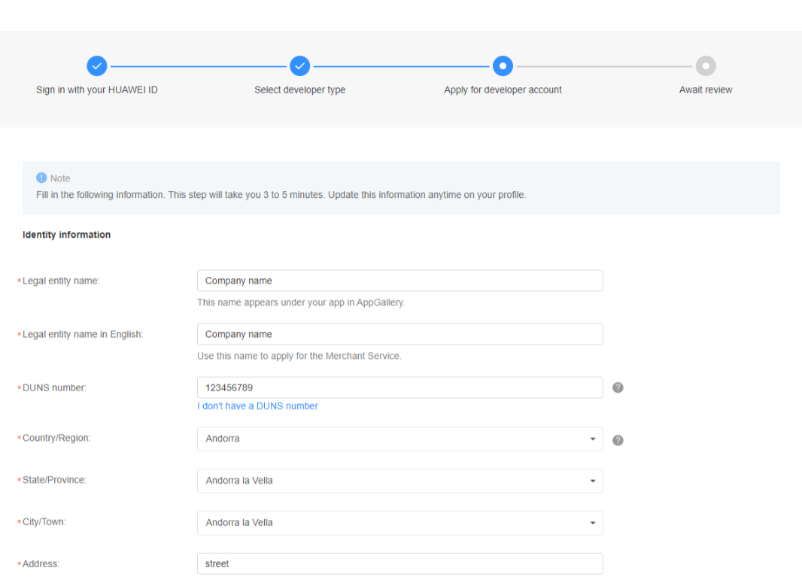
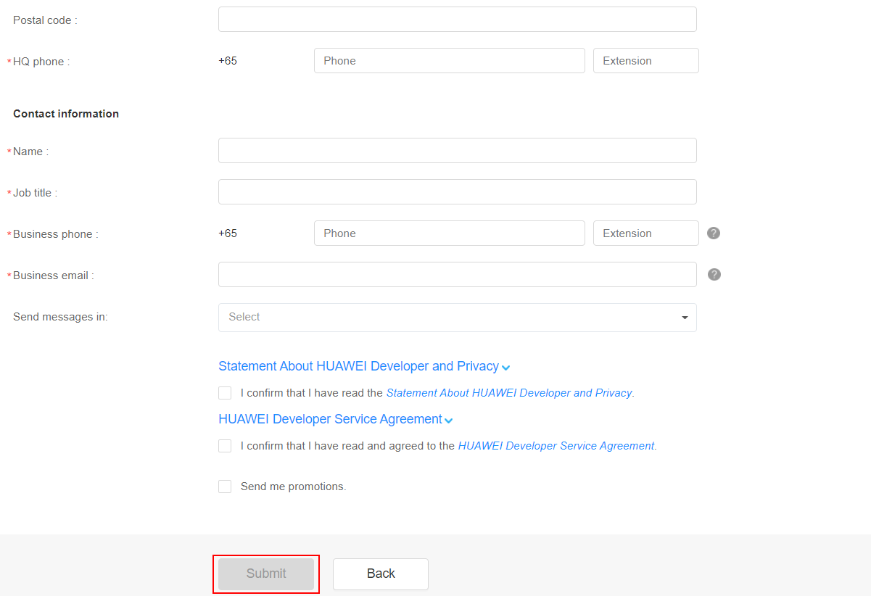
Enterprise Developer Identity Verification

Slide 23
Enterprise Developer Identify Verification
HUAWEI Developers will complete the review within 1 to 2 working days and send the review result to your email address provided in the contact information
You can also check the review result in the notification banner at the top of the HUAWEI Developer platform
If you have any questions during identity verification, you can contact our customer service team by visiting https://developer.huawei.com/consumer/en/support/feedback/#/

Slide 24
Enterprise Developer Identify Verification
You can also use your business license for identity verification instead of your DUNS number
A business license is a legal document issued by a local government agency that allows you to start and operate a business. It contains your company name, registration number, tax number, registration time, and other basic information
Prepare your company's business license before identity verification

Slide 25
Enterprise Developer Identity Verification
On the page for selecting a developer type, click Next under Enterprise.

Slide 26
Enterprise Developer Identity Verification
Click I don't have a DUNS number to show the business license parameters
Enter your identity information and contact information. Parameters marked with a red asterisk (*) are mandatory
Read and confirm the Statement About HUAWEI Developer and Privacy and HUAWEI Developer Service Agreement, and click Submit

Slide 27
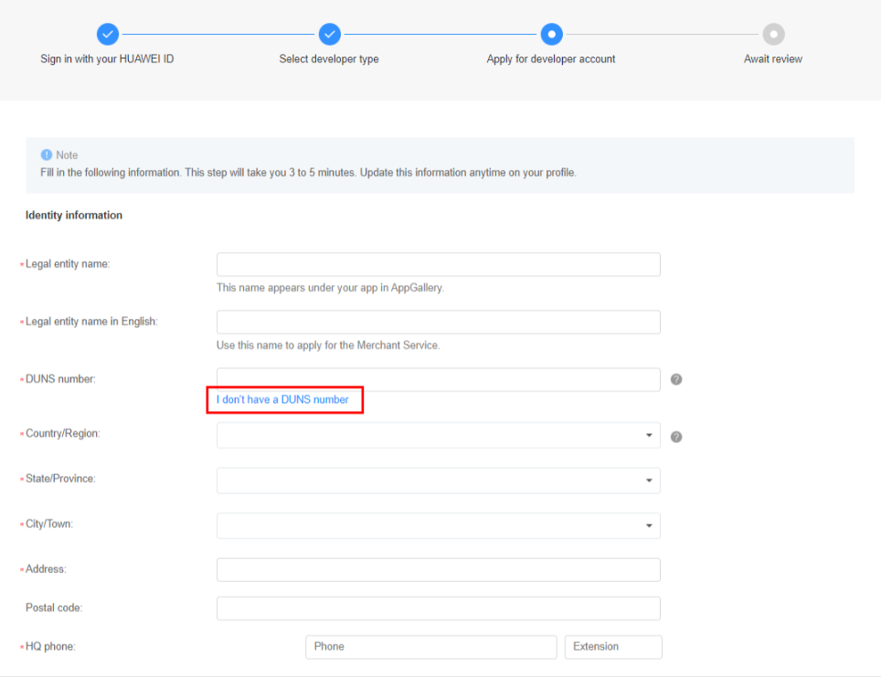
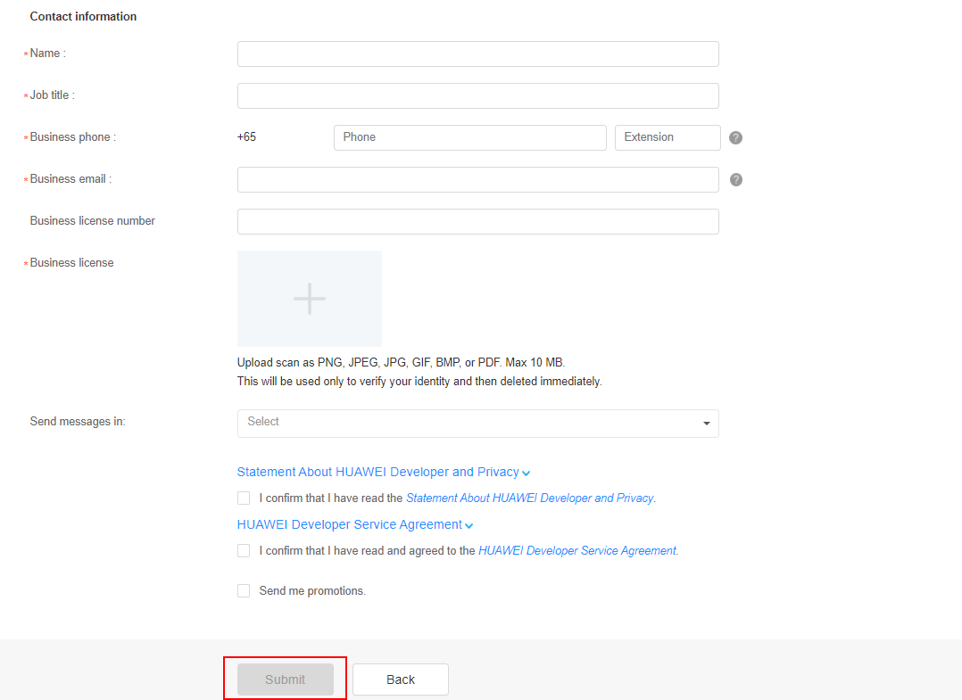
Enterprise Developer Identity Verification

Slide 28
Enterprise Developer Identify Verification
HUAWEI Developers will complete the review within 1 to 2 working days and send the review result to your email address provided in the contact information
You can also check the review result in the notification banner at the top of the HUAWEI Developer platform
If you have any questions during identity verification, you can contact our customer service team by visiting https://developer.huawei.com/consumer/en/support/feedback/#/

Slide 29
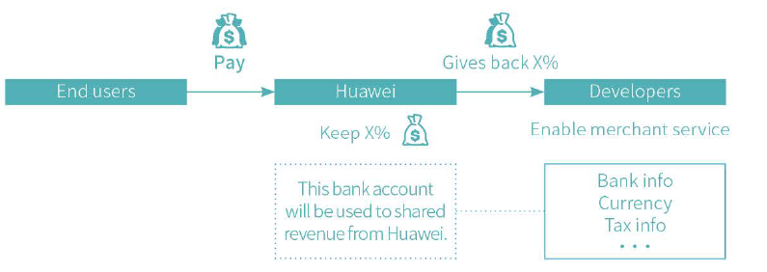
Merchant Service
Enabling the merchant service is a prerequisite for developers to distribute paid content such as the HUAWEI Ads Kit. The bank account and currency information that you enter when enabling the Merchant Service will be used to receive shared revenue from HUAWEI. Merchant Service is available for both individual and enterprise developers.

Slide 30
Merchant Service
To activate the Merchant Service, follow these steps:
Log into the HUAWEI Developer platform using your HUAWEI ID
Go to Console > Settings > Merchant Service
The Merchant Service page will be displayed. Read the HUAWEI Developer Merchant Service Agreement, and sign it if you agree to all the terms and conditions
Fill in your bank account information, tax information, desired payment currency and company contact information. Submit these details for review
Generally you will receive feedback sent to your email address within 2 working days

Slide 31

HUAWEI Ads
ITS ALL ABOUT QUALITY

Slide 32
1
I. Developer Account Registration
2
II. HUAWEI Ads
Contents
3
III. Ad Units and Scenarios
4
IV. HUAWEI Ads Advantages
5
VI. Service Support

Slide 33
HUAWEI Ads Publisher Service: Helping Developers Monetise Traffic
HUAWEI Ads is committed to building an open and compliant ad ecosystem. Developers can obtain more benefits from in-app ads through the Publisher Service.
Develop
Grow
Earn
Product creative
App development
App distribution
User acquisition
Traffic monetisation
Develop and test apps
Release apps in HUAWEI AppGallery
Deliver ads
(obtain app users)
Obtain ad revenue

Slide 34
Quick Four-Step Integration for Monetisation
Step 1
Step 2
Step 3
Step 4
Add an app in HUAWEI Ads Publisher Service.
Select an ad format and create an ad unit.
Integrate the HUAWEI Ads SDK.
Release the app.

Slide 35



Main Functions of HUAWEI Ads Publisher Service
App and ad unit management
Ad effectiveness tracking
Settlement
Supports app adding or deletion
Supports ad unit adding or deletion
Supports brand management (ad blocking by category or advertiser)
Supports report analysis from multiple dimensions
Supports data download
Allows developers to confirm and submit settlement applications after which Huawei will issue payment once the application and invoices have been received

Slide 36
1
I. Developer Account Registration
2
II. HUAWEI Ads
Contents
3
III. Ad Units and Scenarios
4
IV. HUAWEI Ads Advantages
5
V. Integration
6
VI. Service Support

Slide 37





Innovated Ad Formats Bringing a Richer Ad Experience to Users
Banner ads
Rewarded ads
Native ads
Interstitial ads
Splash ads

Slide 38
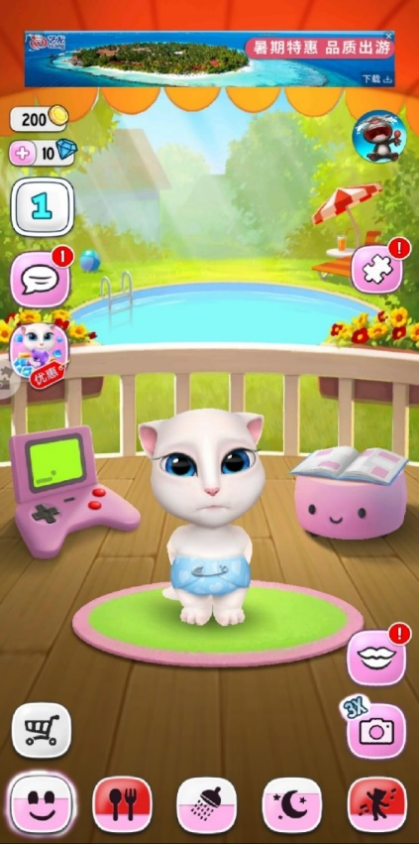
Application Scenario: Banner Ads
Banner ads
If you are new to mobile advertising, banner ads are the way to go.
Features | 1. Fixed ad unit 2. Periodically refreshed 3. Does not interrupt users
Locations | 1. Fixed at the top of the screen 2. Fixed at the bottom of the screen
Standard resolutions | 1080 x 170 1080 x 432
Creative type | Image

Slide 39

Application Scenario: Rewarded Ads
Rewarded ads
Users gain rewards by watching rewarded ads, experiencing the most interesting ads.
Features | 1. High interactivity 2. Improves the app user retention rate
Typical scenarios | 1. Games: rewarded with extra lives, gems, gold coins, etc. 2. Apps: Video app: rewarded with movie coupons Read apps: rewarded with paid books Subscription app: rewarded with free memberships
Standard resolution | 1280 x 720
Creative type | Video
Click an ad
Watch the ad
Obtain a reward
Consume the reward

Slide 40
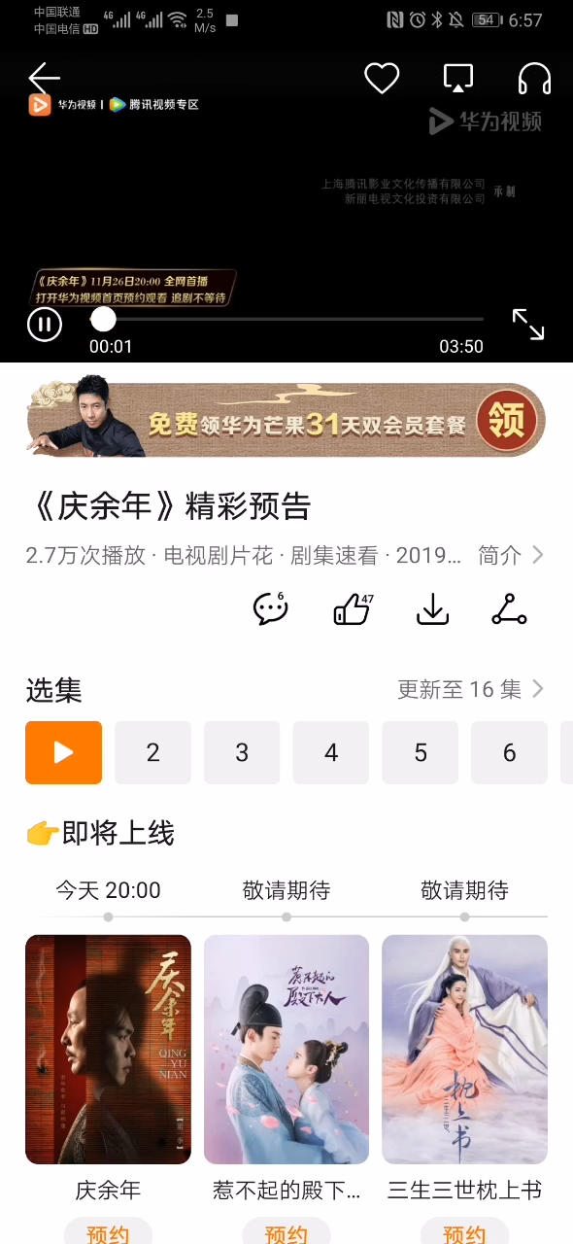
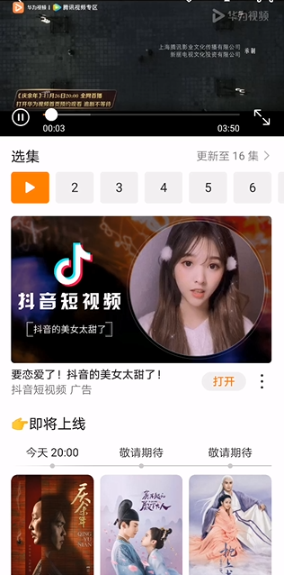
Application Scenario: Native Ads
Native ads
Natural and unobtrusive ads that do not affect user experience.
Features | 1. Seamless integration with app content 2. Applicable to most app screens
Location | Inserted in the middle of a screen
Typical resolutions | 1. Large image with text: 1080 x 607 2. Small image with text: 160 x 160 3. Small image with text/Multiple images with text: 225 x 150 4. Video with text: 640 x 360
Creative types | Video Image

Slide 41
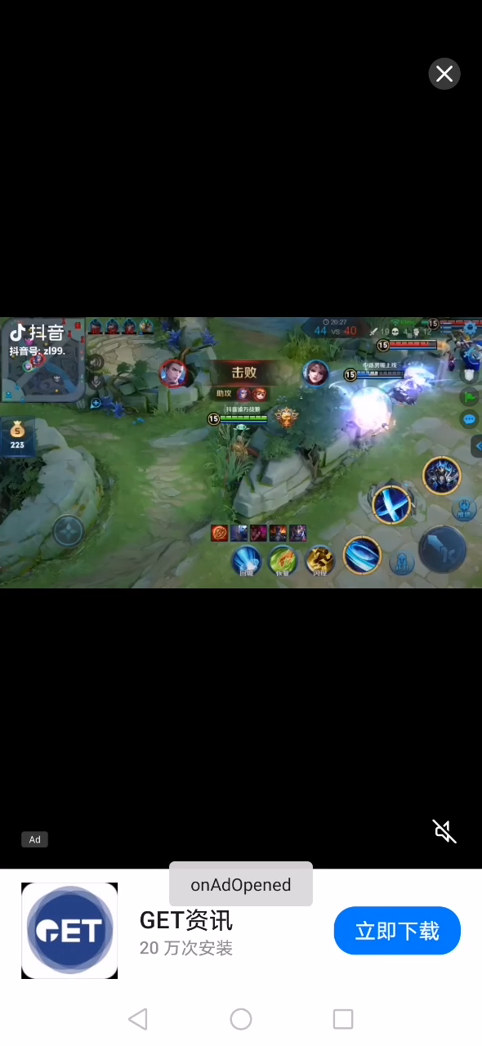
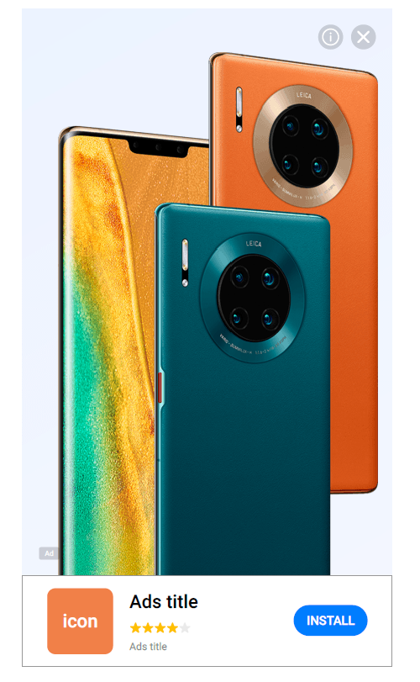
Application Scenario: Interstitial Ads
Interstitial ads
Interstitial ads are displayed in full screen
Features | 1. Displayed in full screen 2. High interactivity
Typical scenarios | 1. Displayed after the app home page is displayed. 2. Displayed when one screen is switched to another.
Standard resolution | 1280 x 720
Creative types | Video Image

Slide 42
1
I. Developer Account Registration
2
II. HUAWEI Ads
Contents
3
III. Ad Units and Scenarios
4
IV. HUAWEI Ads Advantages
5
V. Integration
6
VI. Service Support

Slide 43
HUAWEI Ads Advantages
Better than expected benefits
Security compliance
Ultimate experience
Massive high-quality advertisers
Optimal revenue sharing ratio in the industry
Support from incentive funds of Huawei Mobile Services
Strict review standards and regulations
Compliance with EU GDPR
Dynamic native template for quick integration

Slide 44
Better Than Expected Benefits: Massive High-quality Advertisers to Ensure Developer Revenue
1. Delivery of Huawei-owned ads
2. Promotion of apps from Huawei Mobile Services developers
3. Global market potential
High-quality content and sufficient budget for HUAWEI and HONOR ads attract a large number of top developers.
4A media agents work with advertising sales teams to develop brand advertisers in the global markets.
Developers want to promote a large number of top apps.
44

Slide 45
Better Than Expected Benefits: Optimal Revenue Sharing Ratio in the Industry
The standard developer-platform ad revenue share is 70:30. However, for 2021 developers get a much bigger share of ad revenue.
01 January 2021 – 31 December 2021
80% for developers

Slide 46

Security Compliance: Strict Review Standards and Regulations
A professional review team guarantees ad quality and content compliance with laws and regulations.
Professional and strict review
Strict standards: alignment with the industry's highest standards to ensure ad compliance.
Strict system: review before delivery and inspection after delivery, covering the entire ad delivery process
Dual assurance: automatic and manual review

Slide 47

Security Compliance: Protecting User Privacy
Strictly comply with GDPR to protect user privacy.
Privacy service
Data collection
Data usage
Data sharing

Slide 48
1
I. Developer Account Registration
2
II. HUAWEI Ads
3
III. Ad Units and Scenarios
Contents
4
IV. HUAWEI Ads Advantages
5
V. Integration
6
VI. Service Support

Slide 49
Four Steps to Make HUAWEI ID Work in your app
1. Apply for HUAWEI ID Service
2. Get HMS SDK
3. Coding
4. Test & Release
1.1 Register a HUAWEI Account
2.1 Download the configuration file from AGC
3.1 Build sign request
3.2 Handle Sign result
agconnect-services.json
1.2 Apply for a service in AGC
2.2 Maven & Dependencies Configuration
AGC plugin
HMS SDK
Require Android mobile device’s EMUI version not earlier than 3.0 and Android version not earlier than 4.2.
Developer Portal: https://developer.huawei.com/consumer/en/

Slide 50
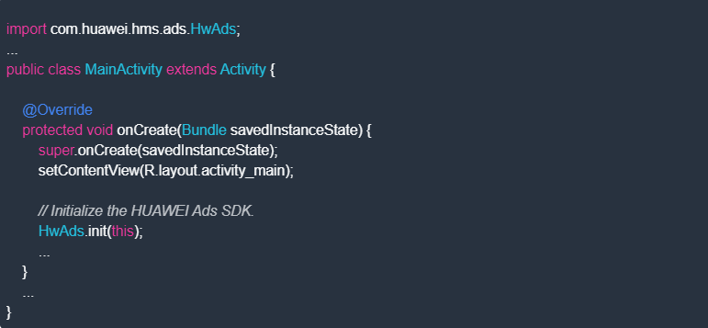
1. Initialising the HUAWEI Ads SDK
To obtain ads using the HUAWEI Ads SDK, you must first initialise the SDK in your app. Call HwAds.init() in the onCreate() method of the MainActivity class to initialize the HUAWEI Ads SDK. MainActivity.java

Slide 51
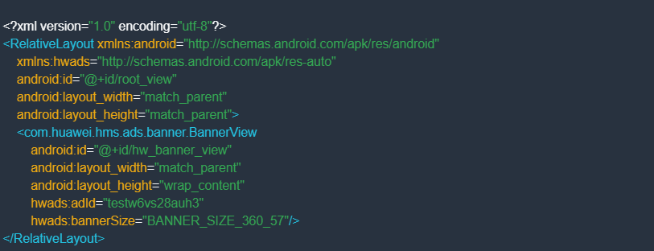

2. Adding a BannerView Class
Editing the XML layout file:
Add BannerView to the XML layout file, and set the hwads:adId and hwads:bannerSize attributes to the ad slot ID and ad size, respectively. The following sample code shows how to add BannerView to the activity_main.xml layout file in the res/layout/ directory. activity_main.xml
Coding
Instead of creating an XML file, you only need to add BannerView in MainActivity.java by referring to the following code and set the ad slot ID and banner ad size (BannerAdSize) by using the setAdId and setBannerAdSize methods respectively: MainActivity.java

Slide 52
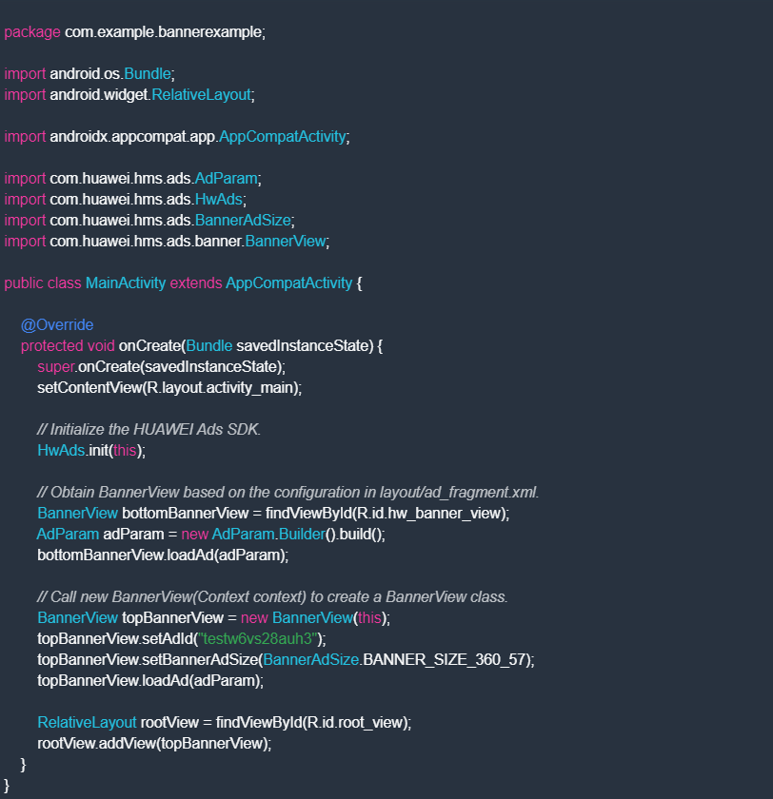
Development Documentation
After BannerView is added, you need to call the loadAd() method of the BannerView class in MainActivity to obtain a banner ad. MainActivity.java

Slide 53
Development Documentation
1.Ads kit development guide:
https://developer.huawei.com/consumer/en/doc/development/HMSCore-Guides-V5/publisher-service-introduction-0000001050064960-V5
2.Ads kit codelab:
2.1 Ads OAID (OAID): https://developer.huawei.com/consumer/en/codelab/HMSAdsOAID/index.html#0
2.2 Ads Kit (Install Referrer): https://developer.huawei.com/consumer/en/codelab//HMSAdsTransformOAID/index.html#4
2.3 Ads Kit (Install Referrer - Kotlin): https://eveloper.huawei.com/consumer/en/codelab//HMSAdsTransformOAID-Kotlin/index.html#0
2.4 Ads Kit (Native Ads): https://developer.huawei.com/consumer/en/codelab/HUAWEIAdsSDK-NativeAds/index.html#2
2.5 Ads Kit (Banner Ads): https://developer.huawei.com/consumer/en/codelab/HUAWEIAdsSDK-BannerAds/index.html#0
2.6 Ads Kit (Rewarded Ads): https://developer.huawei.com/consumer/en/codelab/HUAWEIAdsSDK-RewardedAds/index.html#0
2.7 Ads Kit (Interstitial Ads): https://developer.huawei.com/consumer/en/codelab/HUAWEIAdsSDK-InterstitialAds/index.html#0
2.8 Ads Kit (Splash Ads): https://developer.huawei.com/consumer/en/codelab/HUAWEIAdsSDK-SplashAds/index.html#0

Slide 54
1
I. Developer Account Registration
2
II. HUAWEI Ads
3
III. Ad Units and Scenarios
Contents
4
IV. HUAWEI Ads Advantages
5
IV. Integration
6
VI. Service Support

Slide 55

Comprehensive Service Support
Customer service
Help center
Community
Ready to help any time, with our customer service personnel and technical teams.
Email: developersa@huawei.com
Supports online problem submission and handling.
Can submit a ticket here: link
Developer Forum
Here: link

Slide 56

Questions
Questions

Slide 57
THANKS

